Slide 1
learning outcomes & SNAAP
ATHE Leadership Institute
Montreal, July 2015
Sally Gaskill, Director
Strategic National Arts Alumni Project
Indiana University Bloomington

Slide 2
Notes:
SNAAP collects and analyzes data from people with arts degrees; both undergrad and grad; all arts majors.
We ask questions about educational experiences (at the participating institution) and subsequent careers.
SNAAP is a major arts data source - Over 100,000 arts alumni from some 250 colleges and universities in North America have responded to the survey since 2008.
SNAAP is based at the Indiana University Center for Postsecondary Research, which also is the home of the National Survey of Student Engagement (NSSE).
We publish national research reports under the leadership of Steven Tepper, Research Director.
We are advised by a distinguished National Advisory Board, including Bobbi Korner, co-founder of the ATHE Leadership Institute.

Slide 3
What’s a learning outcome?
“A statement that describes the knowledge or skills students should acquire by the end of a particular assignment, class, course, or program…
…and helps students understand why that knowledge and those skills will be useful to them.”
-A Guide for University of Toronto Faculty
And why are learning outcomes important?

Slide 4
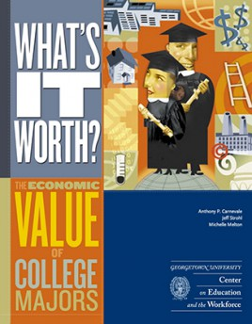
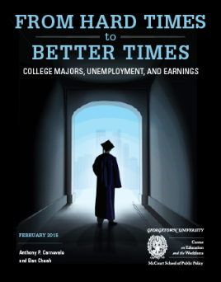
Arts & Humanities Under Fire
Using Census data: Georgetown Center on Education & the Workforce
Notes:
Several years ago, the US Census, through its annual American Community Survey, started asking “what was your college major?”
As a result, a number of new reports have been released – focusing almost exclusively on the importance of the financial value of one’s major.

Slide 5
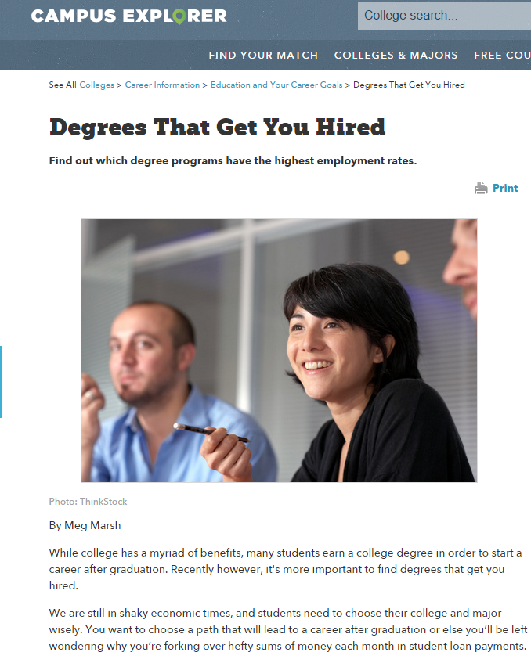
Notes:
Subsequent articles in the popular press focus on salaries.

Slide 6
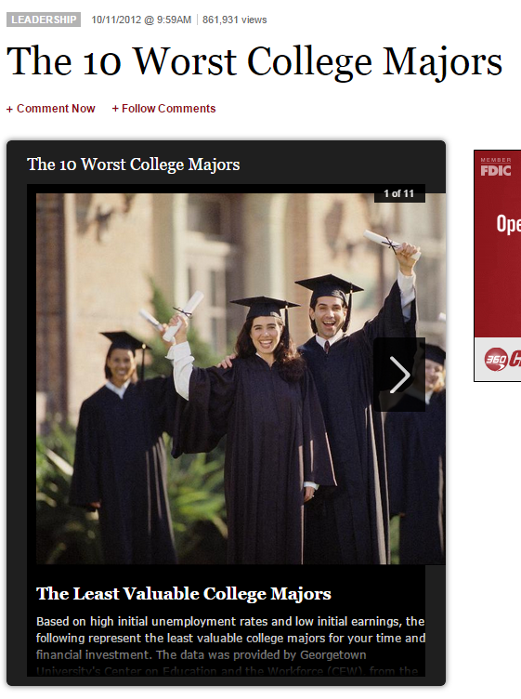
Notes:
Published in FORBES.
#1 Anthropology
#2 is Film, Video & Photographic Arts

Slide 7
AAC&U
Association of American
Colleges & Universities
Founded 1915
1,300 member institutions (international)
Campaign to promote essential learning outcomes for college graduates
Notes:
“The leading national association concerned with the quality, vitality, and public standing of undergraduate liberal education.”

Slide 8
AAC&U Essential Learning Outcomes
(1) Knowledge of Human Cultures and the Physical and Natural World.
through studies in science & math, social sciences, and arts & humanities
focused by engagement with big questions,
both contemporary and enduring

Slide 9
AAC&U Essential Learning Outcomes
(2) Intellectual and Practical Skills, including:
Creative thinking
Critical thinking
Inquiry and analysis
Written and oral communication
Teamwork and problem solving
Quantitative and Information literacy
Practiced extensively, across the curriculum, in the context of progressively more challenging problems, projects, and standards for performance

Slide 10
AAC&U Essential Learning Outcomes
(3) Personal and Social Responsibility, including:
Civic engagement – local and global
Intercultural knowledge and competence
Ethical reasoning and action
Foundations and skills for lifelong learning
Global learning
Anchored through active involvement with diverse communities and real-world challenges

Slide 11
AAC&U Essential Learning Outcomes
(4) Integrative and Applied Learning
Synthesis and advanced accomplishment across general and specialized studies
Demonstrated through the application of knowledge, skills, and responsibilities to new settings and complex problems

Slide 12
What learning outcomes do you want your students to have in their toolkits when they graduate?

Slide 13
UG Theatre Alumni: Skills Learned at Arts School v Needed on the Job
Notes:
Blue column: Percent reporting their institution contributed “some” or “very much” to the development of this skill
Red column: Percent reporting their this skill is “somewhat important” or very important” to their current job
Theatre is significantly higher, when compared to ALL SNAAP respondents in interpersonal relations: only 78% for all respondents v 93% for theatre

Slide 14
UG Theatre Alumni: Skills Learned at Arts School v Needed on the Job
Notes:
Blue: Percent reporting their institution contributed “some” or “very much” to the development of this skill
Red: Percent reporting their this skill is “somewhat important” or very important” to their current job
These are 3 skills in which Theatre ranks much more highly than comparing with ALL arts respondents:
Persuasive speaking –- 80% for Theatre, only 63% for all arts grads
Leadership skills – 83% for Theatre, 66% for all arts grads
Clear writing – 79% for theater, 70% for all arts grads

Slide 15
UG Theatre Alumni: Skills Learned at Arts School v Needed on the Job
Notes:
Blue: Percent reporting their institution contributed “some” or “very much” to the development of this skill
Red: Percent reporting their this skill is “somewhat important” or very important” to their current job
These are skills to work on.

Slide 16
UG Theater Alumni: Skills Learned at Arts School v Needed on the Job
Notes:
Blue: Percent reporting their institution contributed “some” or “very much” to the development of this skill
Red: Percent reporting their this skill is “somewhat important” or very important” to their current job
By far the biggest gaps: Financial and Business Management and Entrepreneurial Skills. True for all arts alumni.

Slide 17
How can we help theatre majors apply what they learn to their careers?

Slide 18
In the arts…
We excel in teaching our students to be creative problem solvers.
94% of SNAAP Theatre majors (UG degree) said their institution helped them acquire or develop creativity “very much” or “some”
But we fall short in teaching our students to be creative in looking at the options available to them after graduation.

Slide 19
Changing the culture
(1) Emphasize the transferrable skills:
Creative problem-solving, critical thinking, dealing with ambiguity, collaborations, deadlines, project management
(2) Organize an event for new majors
(3) Promote internships
Notes:
As administrators – you have the ability to implement some shall shifts in attitude, curricula, and opportunities that you provide to your students.
These ideas were published in a recent SNAAP DataBrief, and are based on a presentation by Colin Blakely at the 2015 College Art Association annual conference.

Slide 20
(4) Get to know the career counseling staff
(5) Broaden the focus of a capstone class
(6) Bring back alumni and celebrate their stories
Notes:
4. Get to know the career counseling staff. How many of you have FT career counselors in your dept?
Talk to the career counselors about careers for your students both in and out of the arts, and help them think broadly about career opportunities. More importantly, show an interest in the work they are doing and they are almost certain to return the favor.
5. Broaden the focus of your capstone class. (How many have one?) Set time aside for a few days in the semester to talk about how to apply for jobs,-- how to audition -- and help students become explicitly familiar with their skillsets. Discuss specific job listings both in and outside of the arts, and brainstorm with students how they might put together a strong set of application materials for each of these jobs.
6. Bring back alumni and celebrate their stories. Bring back successful alumni – both artists as well as those who have gone on to other fields. Esp younger alumni – who your students can relate to.
“I use my acting degree every day in my job as a litigator.”
graduate who started a successful moving company or became a manager at the Apple store just a few years after graduation. The younger alumni tend to have stories that the students can relate to directly, and they love to come back and share their knowledge

Slide 21
(7) Develop some incentives to help your students/alumni expand their experiences.
For current students
For recent alumni
Notes:
What types of incentives might you come up with – to further your students’ abilities to find creative work?
[small fund of cash to support work in the community]

Slide 22
(8) Become familiar with the data (part 1)
The #1 quality valued in employees by the top 500 CEOs in a global IBM study:
creativity
Notes:
Part 1 is general data.

Slide 23
More evidence
Consensus among employers is that innovation, critical thinking, and a broad skill set are important for taking on complex challenges in the workplace.
--Hart Research
Notes:
Credit: Steven J. Tepper

Slide 24
What’s important to college seniors?
92% of all college seniors say that a career that allows them to be creative is important
-- 2012 Teagle Study on Double Majors
Notes:
Credit: Steven J. Tepper

Slide 25
Nonlinear Career Paths
25% of 18-44 year olds held 15 or more jobs in their lifetimes (the average number is 11 jobs)
One-third of U.S. workers say they expect to be working in a different job next year
Notes:
Credit: Steven J. Tepper

Slide 26
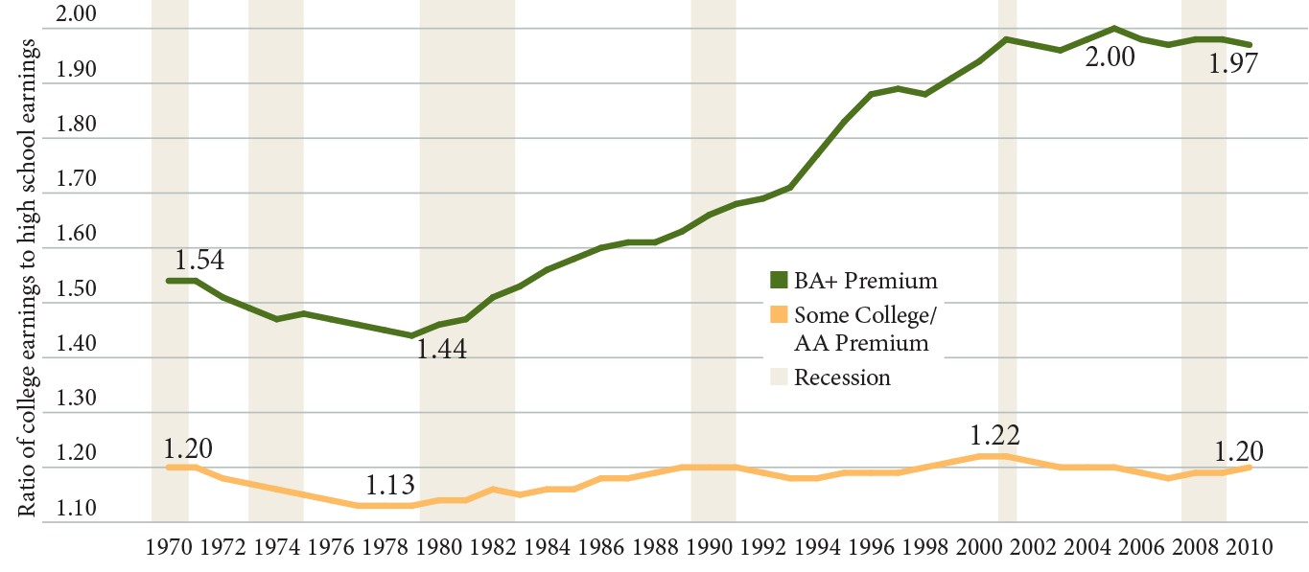
The College Earnings Premium
The College Earnings Premium
Source: Carnevale, Jayasundera, and Cheah (2013)
Notes:
Credit: Georgetown Center on Education and the Workforce

Slide 27
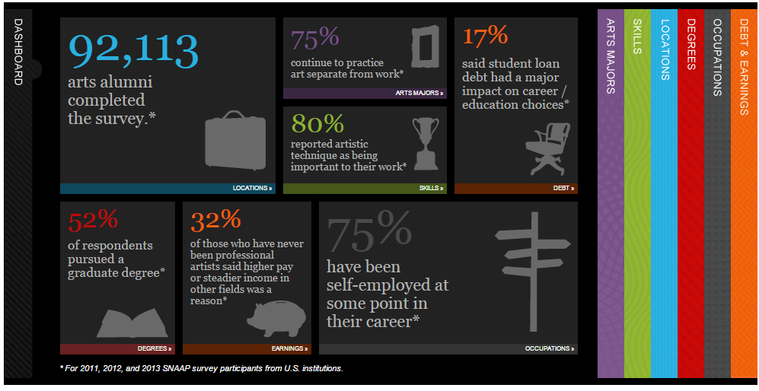
(8) Become familiar with data (part 2)
DataBriefs, Reports, Presentations, SnaapShot
www.snaap.indiana.edu
Notes:
Part 2: SNAAP data
Ideally each institution will have itsown SNAAP data – that’s the most powerful tool with which to make change.

Slide 28
SNAAP data on overall satisfaction of arts alumni
76% would attend their institution again
90% say their overall experience in art school was either very good or excellent.
87% are satisfied with their current jobs
82% are satisfied with their ability to be creative in their work

Slide 29
SNAAP data on how long to first job
 |  | Theater Majors (UG)
Obtained work prior to leaving [INSTITUTION] |  | 34%
Obtained work in less than four months |  | 32%
Obtained work in four to twelve months |  | 14%
Obtained work after more than a year |  | 7%
Have not yet found work |  | 2%
Did not search for work after leaving program |  | 2%
Pursued further education |  | 11%

Slide 30
And is that first job related to your major?
All SNAAP Undergrads:
47% Closely Related
19% Somewhat Related
10% Not related
For those with Graduate Degrees:
62% Closely related
17% Somewhat related
9% Not related
Notes:
Does not add up to 100% because:
2% did not search for work
2% are still looking for work
11% pursued further education

Slide 31
What do arts graduates do?
Notes:
Interactive website: snaap.indiana.edu/snaapshot

Slide 32
A theater degree = waiting tables (right?)
ONLY 3% CURRENTLY WORK IN
FOOD SERVICE.

Slide 33
Thank you!
Sally Gaskill
Director
Strategic National Arts Alumni Project
Center for Postsecondary Research
Indiana University School of Education
Bloomington, Ind.
gaskill@indiana.edu
snaap.indiana.edu
812-856-5824

