Slide 1
Diversity in Leadership Among Arts Graduates
Presenter:
Marisol D’Andrea, PhD
Wednesday, October 20, 2021
SNAAP Conference

Slide 2
Overview
Background
Research Overview
Leadership Literature
Methodology
Theoretical Framework
Findings
Limitations
Implications
Conclusions

Slide 3
Background
1
2
3
4
Visual Artist
Researcher
Author
Performer

Slide 4
I explore the magnitude of diversity reflected among leaders with an art degree based on gender, ethnicity, and age. This study includes leaders who are managers, arts administrators, curators, arts educators, theatre producers, and stage directors.
Research Overview

Slide 5
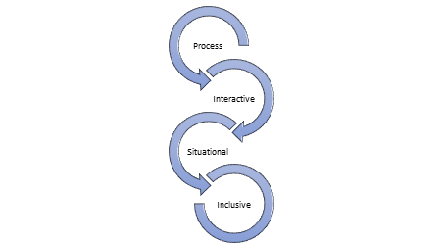
Leadership Literature
Key Features of
Leadership

Slide 6
- Operational Variables
- Descriptive Approach
Methodology
SNAAP Data (2015, 2016 & 2017)

Slide 7
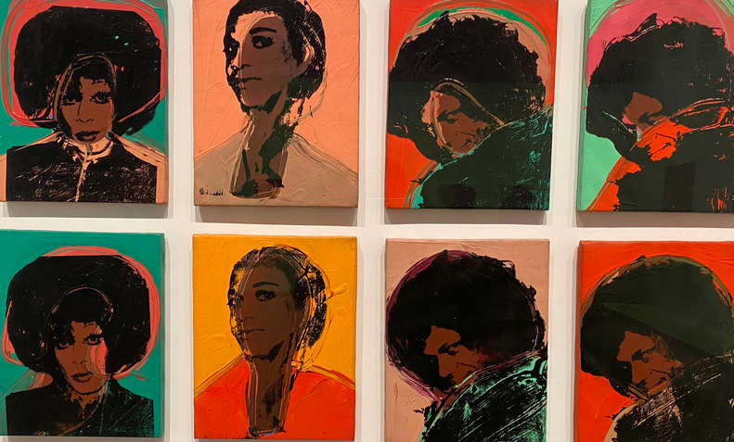
Intersectionality
Theoretical Framework
Examines intersections of gender, ability, race, and sexuality
(Cole, 2009; Kelly & Carton, 2020; Sanchez-Hucles & Davis, 2010)
Portraits from Andy Warhol's 1975
"Ladies & Gentlemen" series. AGO, August 2021

Slide 8
Finding 1 - Occupations

Slide 9
Finding 2 - Gender

Slide 10
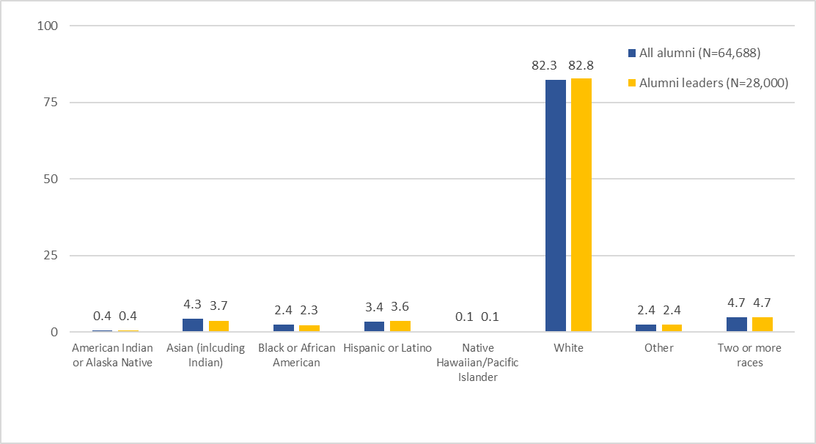
Finding 3 - Ethnicity

Slide 11
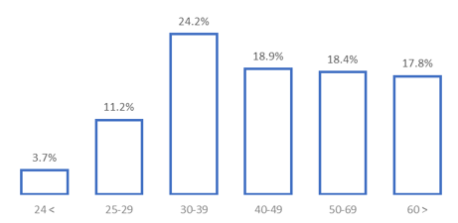
Finding 4 – Age, Alumni Leaders

Slide 12
Limitations
Quantitative Data Reliance
Data
Leadership
Proxy Leadership Variables
Future Research
Qualitative Study
Arts Org. Vs. Non-Art Inst.

Slide 13
Implications
1
2
3
4
Assessment
of “inclusiveness” and the exploration of the role of the “gatekeepers” with the power to exercise equity and equality
Vision and Mission on inclusiveness
Monitoring performance of leaders and requiring accountability in achieving diversity and inclusivity goals
Creation
of inclusive leadership education

Slide 14
Conclusion
Diversity makes us all richer
~ Mallia, 2019, p. 213

Slide 15

Thanks!
Credit: PPT Template by Slidesgo & Freepick

